Slide 1
Mathematics (9-1) - iGCSE
2018-20
Year 09
Unit 15 – Answers

Slide 2
15 - Prior knowledge check
Page 685
a. 3$\sqrt{3}$ b. 10$\sqrt{2}$ c. 2$\sqrt{5}$
a. Quadratic b. Cubic c. Quadratic d. Linear e. Linear f. Cubic g. Linear
a. -7 b. 6 c. 7 d. -3 e. 12

Slide 3
15 - Prior knowledge check
Page 685
a. x ≥ 3 b. 2 < x c. x > 7 d. x ≤ 5
X
0 1 2 3 4 5 6 7 8
X
0 1 2 3 4 5 6 7 8
X
0 1 2 3 4 5 6 7 8
X
0 1 2 3 4 5 6 7 8

Slide 4
15 - Prior knowledge check
Page 685
a. (x: x < -12) b. (x: x > -3) c. (x: x ≥ 0) d. (x: x ≤ 1.4)
a. -2, -1, 0, 1, 2, 3 b. -2, -1, 0 c. 0, 1 d. 15, 16, 17, 18, 19, 20, 21, 22
a. x² * 10x + 21 b. x2 + 3x - 40 c. x² - 5x + 6 d. x² - 8x + 16 e. 2x² + 13x + 15 f. 3x² - 11x + 10 g. 9x² - 1

Slide 5
15 - Prior knowledge check
Page 685
a. (x + 5)(x + 2) b. (x - 3) (x + 1) c. (x + 5)(x - 3) d. (x - 7) (x + 1) e. (x - 1)(x + 1) f. 3 (x + 1) (x +4) g. (2x +5) (x - 2)
x = -2 or x = $\frac{5}{3}$
a. (x - 3)² + 3 b. (x - 4)² - 5 c. 3(x -1)² + 6

Slide 6
15 - Prior knowledge check
Page 685
a. x = 5 or x = -1 b. x = 0 or x = -2 c. x = - $\frac{3}{2}$ ± $\frac{\sqrt{29}}{2}$ d. x = 1 or x = -3
a. y = 7, x = -1 b. y = 5, x = 3 c. x = 3 and y = -5 or x = -1 and y = 3
a. x = -0.4 or x = -4,6 b. x = 1.9 or x = -1.1

Slide 7
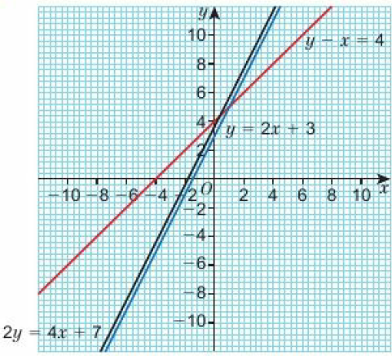
15 - Prior knowledge check
Page 685
a. i, iii b. iv c. iii

Slide 8
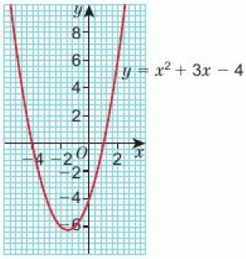
15 - Prior knowledge check
Page 685
a. b. i. x = 1 or x = -4 ii. x = -4.4 or x = 1.4
Any of the form ax² – 5ax -14a

Slide 9
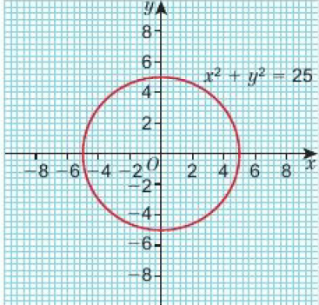
15.1 – Solving Simultaneous Equations Graphically
Page 685

Slide 10
15.1 – Solving Simultaneous Equations Graphically
Page 686
a. b. (2, 8)

Slide 11
15.1 – Solving Simultaneous Equations Graphically
Page 686
a. i. B ii. A iii. C b. i. (1, 4) ii. (4, 1) iii. (0, 2)
a. x = 1, y = 6 b. x = 3, y = 9 c. x = -1, y = 7 d. x = -2, y = -3
4x + 2y = 256 3x + 3y = 249 a. 37p b. 46p

Slide 12
15.1 – Solving Simultaneous Equations Graphically
Page 686
a. Stream Speed: y = 20 +1.5x, Online: y = 2x b. 40GB
x = 1.3, y = 0.3 or x = -2.3, y = -3.3
a. x = 3, y = -2 b. x = -1.5, y = 4.75

Slide 13
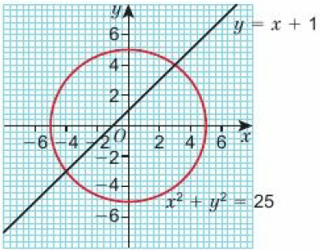
15.1 – Solving Simultaneous Equations Graphically
Page 686
a. b. c. (3, 4) and (-4, 3)
x = -1.6, y = 2.6 or x = 2.6, y = -1.6

Slide 14
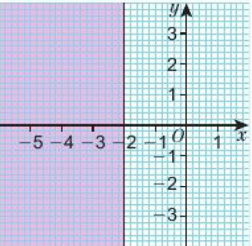
15.2 – Representing Inequalities Graphically
Page 686
a. {x: x ≤ 6} b. {x: x < -2} c. {x: x ≤ 4}
a. i. x < 2 ii. y ≤ 4 iii. -1 ≤ x ≤ 3 b. i.

Slide 15
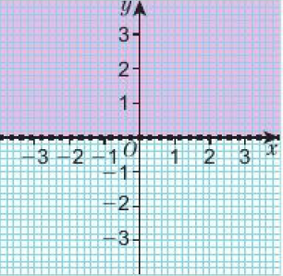
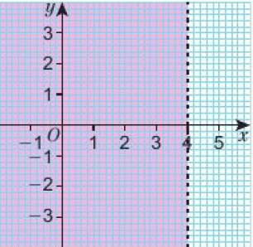
15.2 – Representing Inequalities Graphically
Page 686
b. ii. iii.

Slide 16
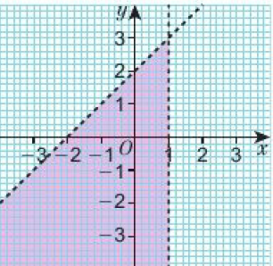
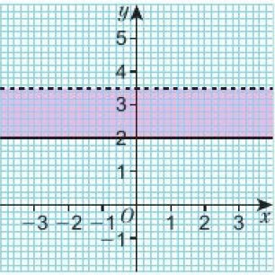
15.2 – Representing Inequalities Graphically
Page 686
b. iv. v.

Slide 17
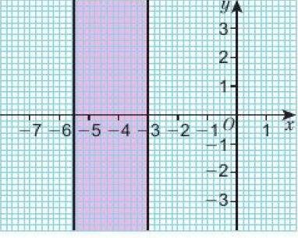
15.2 – Representing Inequalities Graphically
Page 686
b. vi. vii.

Slide 18
15.2 – Representing Inequalities Graphically
Page 687
a. b. d. c. Yes

Slide 19
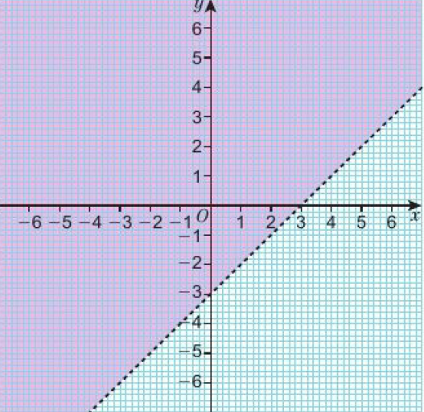
15.2 – Representing Inequalities Graphically
Page 687
a.

Slide 20
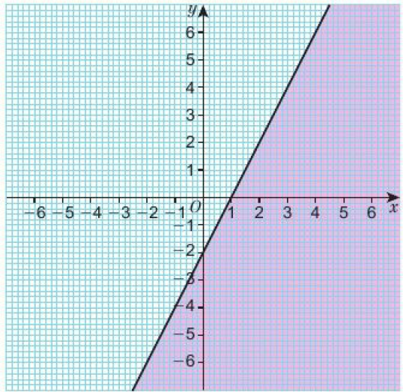
15.2 – Representing Inequalities Graphically
Page 687
b.

Slide 21
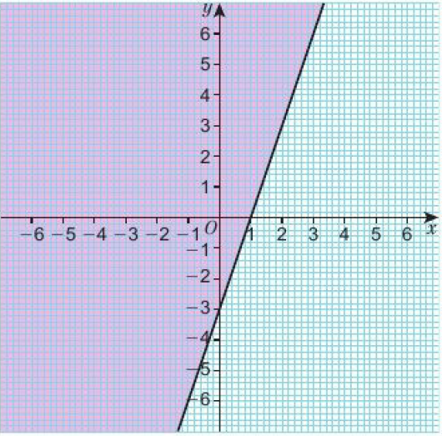
15.2 – Representing Inequalities Graphically
Page 687
c.

Slide 22
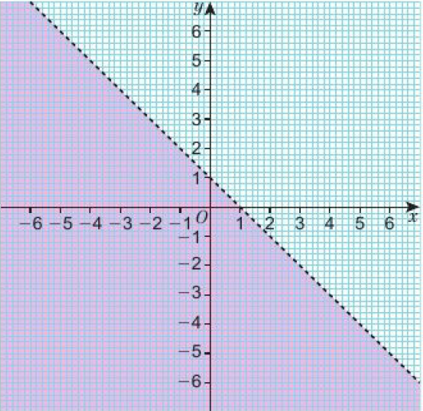
15.2 – Representing Inequalities Graphically
Page 687
d.

Slide 23
15.2 – Representing Inequalities Graphically
Page 688

Slide 24
15.2 – Representing Inequalities Graphically
Page 688

Slide 25
15.2 – Representing Inequalities Graphically
Page 688
a. i. y = 3, y = 3x – 2, x = -2 ii. y < 3, y > 3x – 2, x ≥ -2 b. i. x = 2, y = x + 2, y = -x - 2 ii. y ≤ x + 2, y ≥ -x – 2, x < 2 c. i. y = 2x - 3, y = -3x, y = 5 ii. y > 2x - 3, y > -3x – 2, x ≤ 5
3 points

Slide 26
15.2 – Representing Inequalities Graphically
Page 688
a. x < -1, x > 2 b. x < -1, x > 2

Slide 27
15.2 – Representing Inequalities Graphically
Page 688
a. b. {x: -2 ≤ x ≤ 1}
{x: x ≤ -3} ∪ {x: x > $\frac{1}{2}$}

Slide 28
15.2 – Representing Inequalities Graphically
Page 688
a. b. {x: x > 3} ∪ {x: x < -2}

Slide 29
15.2 – Representing Inequalities Graphically
Page 688
a. {x: -4 < x < 3} b. {x: x ≥ 2} ∪ {x: x ≤ -1} c. {x: x ≥ 3} ∪ {x: x ≤ -3}

Slide 30
15.3 – Graphs of Quadratic Functions
Page 688
a. x = -2, x = -1 b. x -1.5, x = -4
a. (x + 1)² - 6 b. 2(x + 2)² - 4
a. (1, 7) b. x = 1

Slide 31
15.3 – Graphs of Quadratic Functions
Page 689
a. x = -1 and x = -3 b. (0, 3) c. Minimum d. (-2, -1)

Slide 32
15.3 – Graphs of Quadratic Functions
Page 689
a.
x = -3 and x = -5 c. (0, 15)
Minimum d. (-4, -1)

Slide 33
15.3 – Graphs of Quadratic Functions
Page 689
a. i. x = -3 and x = -1 ii. x = -5 and x = -3 b. i. 3 ii. 15
a. iii b. iv c. ii d. I
a. Minimum (1, 3) b. Maximum (-3, -2) c. Minimum (5, -2) d. Minimum (-3, -5) e. Minimum (2, 1) f. Maximum (-1, 4)

Slide 34
15.3 – Graphs of Quadratic Functions
Page 689
g
a. (x - 4)(x + 2) b. (4, 0) and (-2, 0) c. (0, -8) d. (x - 1)² - 9 e. (1, -9) f. Minimum, coefficient of x is positive.

Slide 35
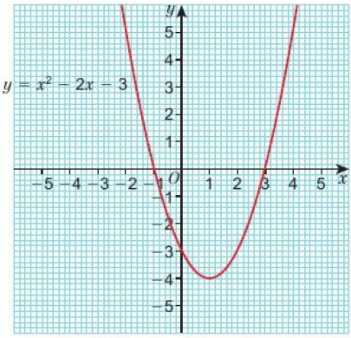
15.3 – Graphs of Quadratic Functions
Page 689
a.

Slide 36
15.3 – Graphs of Quadratic Functions
Page 689
b.

Slide 37
15.3 – Graphs of Quadratic Functions
Page 690
c.

Slide 38
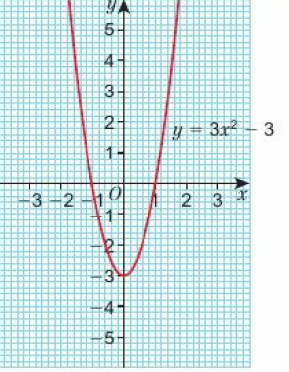
15.3 – Graphs of Quadratic Functions
Page 690
d.

Slide 39
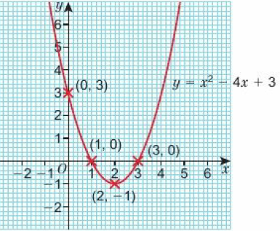
15.3 – Graphs of Quadratic Functions
Page 690
a. x = 3 or x = 1 b.

Slide 40
15.3 – Graphs of Quadratic Functions
Page 690
a. (-3, -5) b. (-3 ± $\sqrt{5}$, 0)
a. x = -1 ± $\sqrt{3}$ b. x = -2 or x = 4 c. x = -2 ±$\frac{2}{\sqrt{3}}$
a. x = -2 ± $\sqrt{7}$ b. x = 2 ±$\frac{3}{\sqrt{2}}$ c. x = -3 ± $\sqrt{13}$

Slide 41
15.3 – Graphs of Quadratic Functions
Page 690
The graphs should have a maximum since the coefficient of x is negative. The graph should cross the y-axis at (0, 6). The graph should have roots at x = 3 and x = -1. The graph should have a turning point at (1, 8).
y = x² + 4x + 1

Slide 42
15.4 – Solving Quadratic Functions Graphically
Page 690
a. x = -5 or x = -1 b. -1 ± $\frac{\sqrt{6}}{2}$ c. -1 ±$\frac{2}{\sqrt{3}}$
a. x = 5.3 and x = -1.3 b. x = 2.4 and x = -0.9 c. x = -1.0 or x = 1.7
a. Graph i, x = -1.3 and x = 5.3 b. Graph iii, x = 1.5 and x = 1.1 c. Graph iv, x = -1.2 and x = 3.2 d. Graph ii, x = 0.4 and x = -1.4

Slide 43
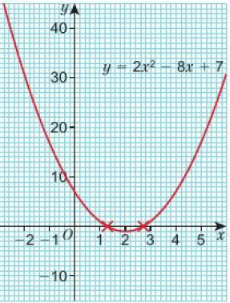
15.4 – Solving Quadratic Functions Graphically
Page 690
a. b. c. 2.7 and 1.3.
x | -2 | -1 | 0 | 1 | 3 | 5
y | 31 | 17 | 7 | 1 | 1 | 17

Slide 44
15.4 – Solving Quadratic Functions Graphically
Page 690
a. Students’ own graphs b. i. x = -5.3 and x = 1.3 ii. x = -3.6 and x = 0.6 iii. x = 2.4 and x = -0.4 iv. x = 2.5 and x = -0.5

Slide 45
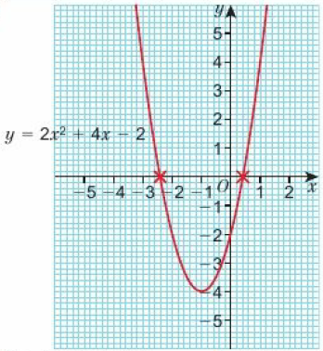
15.4 – Solving Quadratic Functions Graphically
Page 690
a. b. c. x = -2.4 and x = 0.4 d. 2(x + 1)² -4
x | -4 | -3 | -2 | -1 | 0 | 1 | 2
y | 14 | 4 | -2 | -4 | -2 | 4 | 14

Slide 46
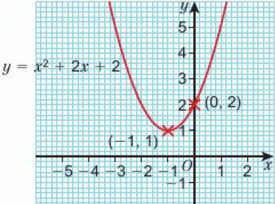
15.4 – Solving Quadratic Functions Graphically
Page 690
a. i. (-1, 1) ii. (0, 2) iii.

Slide 47
15.4 – Solving Quadratic Functions Graphically
Page 691
b. i. (-2, -3) ii. (0, -7) iii.

Slide 48
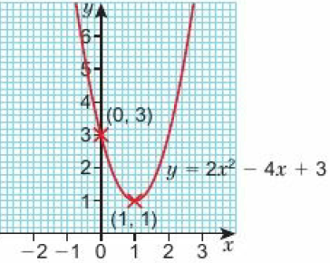
15.4 – Solving Quadratic Functions Graphically
Page 691
c. i. (1, 1) ii. 3 iii.

Slide 49
15.4 – Solving Quadratic Functions Graphically
Page 691
The minimum is at (3,5) therefore the graph has no roots
a. 0 roots b. 2 roots c. 2 roots d. 1 root e. 0 roots f. 2 roots g. 1 root h. 2 roots
a. x = 2 ± $\sqrt{7}$ b. x² - 7x + 13 = 0 (x - $\frac{7}{2}$)² - $\frac{49}{4}$ + 13 = 0 (x - $\frac{7}{2}$)² - $\frac{49}{4}$ = - $\frac{3}{4}$ There are no real roots of a negative number. OR The graph has a turning point at ($\frac{7}{2}$, $\frac{3}{4}$). Since this is a minimum the whole graph is above the x-axis.

Slide 50
15.4 – Solving Quadratic Functions Graphically
Page 691
a. y = x² – x - 2 b. y = x²- 10x + 21 c. y = x² + 4x + 4
a. 3.23607 b. 5.79156 c. -1.30278

Slide 51
15.4 – Solving Quadratic Functions Graphically
Page 691
a. y = x² – x - 2 b. y = x²- 10x + 21 c. y = x² + 4x + 4
a. 3.23607 b. 5.79156 c. -1.30278

Slide 52
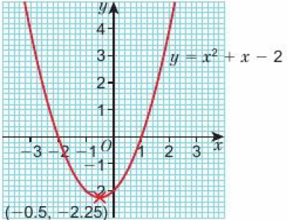
15.4 – Solving Quadratic Functions Graphically
Page 691
a. x = -2 and x = 1 b. c. {x: -2 < x < 1} d. {x: x < -2} ∪ {x: x > 1}

Slide 53
15.4 – Solving Quadratic Functions Graphically
Page 691
a. {x: -1 < x < 3} b. {x: -5 < x < 2} c. {x: x < -4} ∪ {x: x > -1}

Slide 54
15.5 – Graphs of Cubic Functions
Page 691
a. x² + 5x + 6 b. x² + x – 12 c. 2x² - 9x - 5 d. 3x²- 10x + 8
a. x = 5 or x = -2 b. x = 1 or x = -1 c. x = 3 or x = -1 d. x = -2 or x = $\frac{1}{3}$
x³ + 6x² + 9x + 2
x³ + 9x² + 26x + 24

Slide 55
15.5 – Graphs of Cubic Functions
Page 691
a. x³ + 8x² + 17x + 10 b. x³ - x² - 14x + 24 c. x³ + 4x² + x – 5 d. x³ + x² + 27x + 27 e. x³ + x² - x – 1 f. x³ + 9x² + 27x + 27
a. x = -4, x = -1, x = 2 b. (0, -8)

Slide 56
15.5 – Graphs of Cubic Functions
Page 691
a. x = -1, x = -2, x = -5 b. (0, 10) c.

Slide 57
15.5 – Graphs of Cubic Functions
Page 691
a. iv b. iii c. i d. v e. vi f. ii
a. 3 b. 1 repeated root c. 3 d. 2 (one repeated) e. 1 f. 3

Slide 58
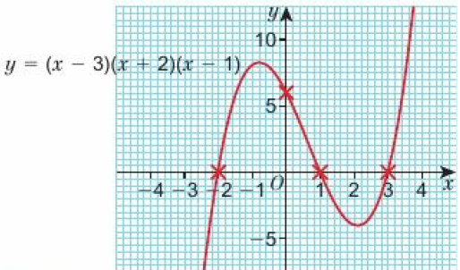
15.5 – Graphs of Cubic Functions
Page 691
a.

Slide 59
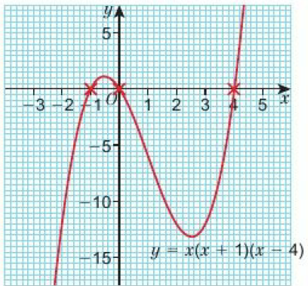
15.5 – Graphs of Cubic Functions
Page 691
b.

Slide 60
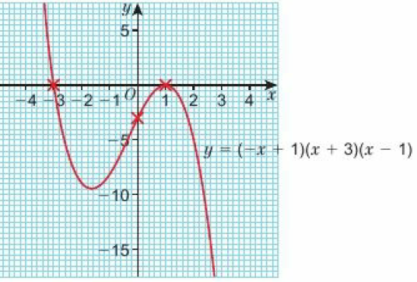
15.5 – Graphs of Cubic Functions
Page 692
c.

Slide 61
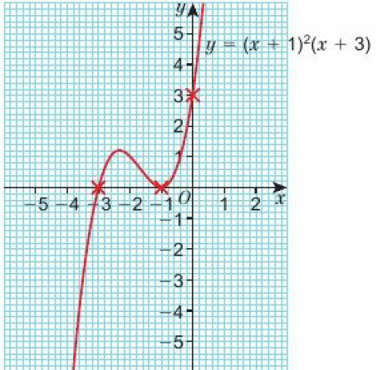
15.5 – Graphs of Cubic Functions
Page 692
d.

Slide 62
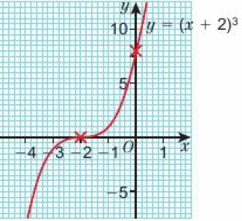
15.5 – Graphs of Cubic Functions
Page 692
e.

Slide 63
15.5 – Graphs of Cubic Functions
Page 692

Slide 64
15.5 – Graphs of Cubic Functions
Page 692
a = 2, b = -9, c = -18
a = 3, b = 6, c = -8
x = 1.4562
x = 1.9122

Slide 65
15 – Problem Solving
Page 692
Approximately -24°C
3.5 metres
a. 25.60 AED b. £9.74
a. House prices are increasing faster than earnings, b. Approximately 12.5 c. House prices have increased, or earnings have decreased, more than expected.
a. 6.5 metres b. 3.1 metres

Slide 66
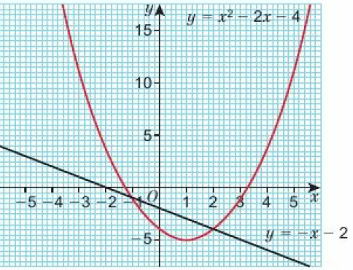
15 – Check Up
Page 692
Package A: y = 0.1x b. 400 minutes Package B: y = 20 + 0.05x
x = 2, y = -4 and x = -1, y = -1

Slide 67
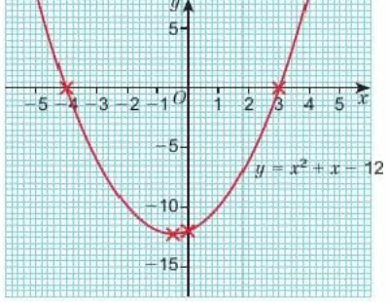
15 – Check Up
Page 692
y < 2x – 1, x ≤ 2, y ≥ -2
a. b. c. (x: -4 < x < 3)

Slide 68
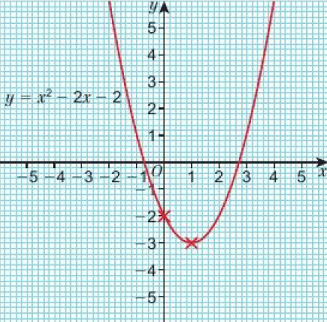
15 – Check Up
Page 692
a. b. 2.7 and -0.7 c. Iterative equation:
x_{n+1} = $\sqrt{2xn+2}$ x = 2.73205

Slide 69
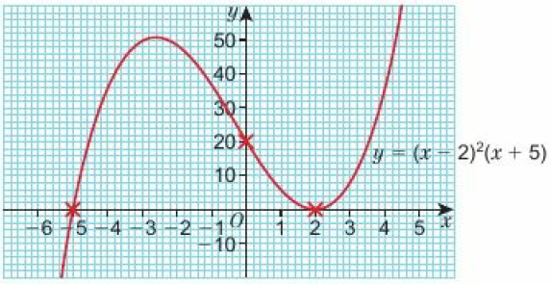
15 – Check Up
Page 693
Functions of the form: y = a(x + 1)(x - 3) and y = a(x + 1)2(x - 3) and y = a(x - 3)(x + 1) and y = a(x + b)(x - 3)

Slide 70
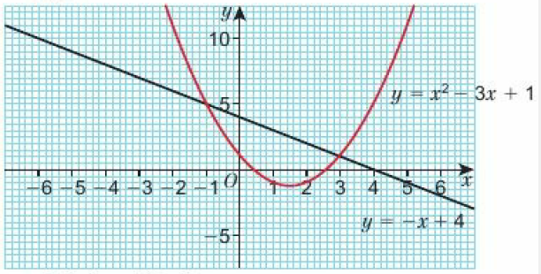
15 – Strengthen
Page 693
Simultaneous equations and inequalities
a. b, c. d. (3, 1) and (-1, 5) e. x = 3, y = 4 or x = -1, y = 0
x | -2 | -1 | 0 | 1 | 2 | 3 | 4 | 5
y | 11 | 5 | 1 | -1 | -1 | 1 | 5 | 11

Slide 71
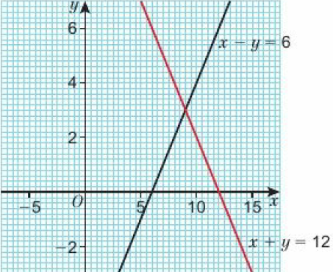
15 – Strengthen
Page 693
a. (3, 1) and (-1, 5) b. x = 3, y = 4 or x = -1, y = 0
a. x + y = 12 b. x – y = 6 c. d. x = 9, y = 3 or y = 3, x = 9, depending on how they have written the original fractions.

Slide 72
15 – Strengthen
Page 693
y ≤ x + 2, x ≤ 2, y > -3
y < 1, y ≥ x - 3, y ≥ -x y = x
a, b, d, f. c. Yes d. No

Slide 73
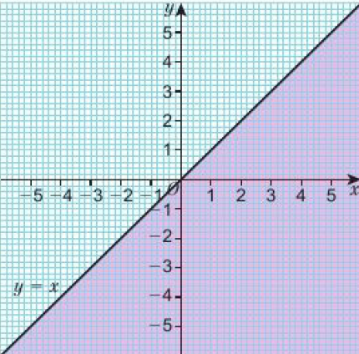
15 – Strengthen
Page 693
a.

Slide 74
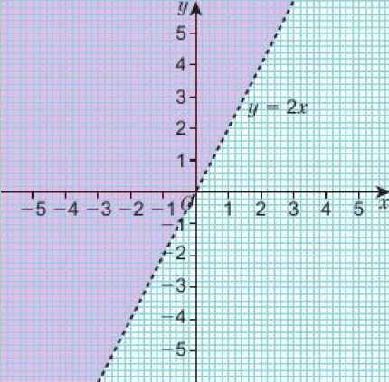
15 – Strengthen
Page 693
b.

Slide 75
15 – Strengthen
Page 693
c.

Slide 76
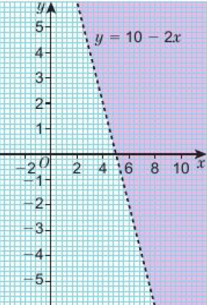
15 – Strengthen
Page 694
d.

Slide 77
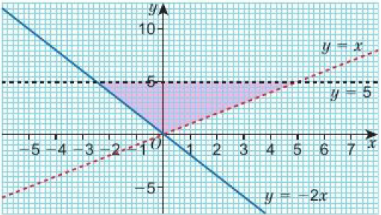
15 – Strengthen
Page 694

Slide 78
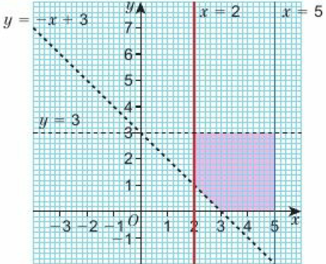
15 – Strengthen
Page 694

Slide 79
15 – Strengthen
Page 694
Graphs of Quadratic Functions
a. Roots:-1, 3 y-intercept: -6 b. Roots: -3, 1 y-intercept: -9 c. Roots: -2, 2 y-intercept: 4 d. Roots: 1, 4 y-intercept: -4

Slide 80
15 – Strengthen
Page 694
a. When y = 0 x² + 2x - 8 = 0 (x - 2)(x + 4) = 0 There are two possible solutions: x - 2 = 0 hence x = 2 x + 4 = 0 hence x = -4 So the roots are x = 2 and x = -4.
When x = 0 y = x² + 2x - 8 y = 0³ - 0 - 8 y = - 8 So the intercept with the y-axis is y = -8.

Slide 81
15 – Strengthen
Page 694
a. roots: 5 or - 3, y-intercept: -15 b. roots: -8 and 2, y-intercept: 16 c. roots: -0.5 and 3, y-intercept: -6 d. roots: 1 or -5, y-intercept: -15
a. y = (x + 1)² - 1 – 8 y = (x + 1)² - 9 b. (-1, -9) c. Minimum
a. (1, -16), minimum b. (-3, 25), maximum c. (1, -8), minimum d. (-2, -27), minimum

Slide 82
15 – Strengthen
Page 694
a.

Slide 83
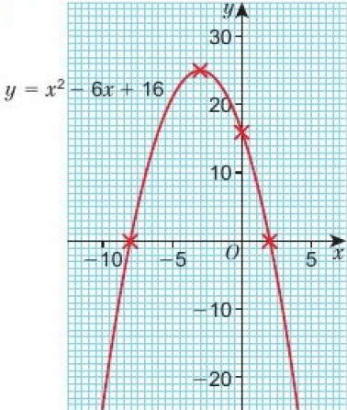
15 – Strengthen
Page 694
b.

Slide 84
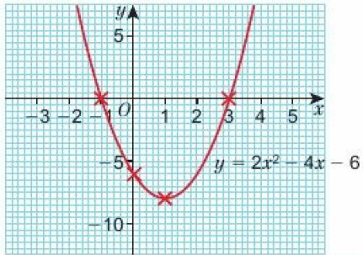
15 – Strengthen
Page 694
c.

Slide 85
15 – Strengthen
Page 694
d.

Slide 86
15 – Strengthen
Page 694
a. -3 < x < 5 b. x < -3 and x > 5
a.

Slide 87
15 – Strengthen
Page 694
b.

Slide 88
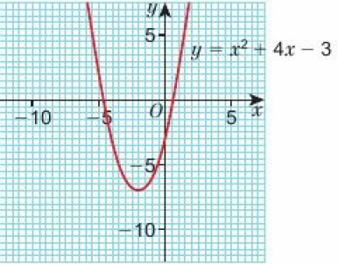
15 – Strengthen
Page 694
a. b. 0.6, -4.6
x | -5 | -4 | -3 | -2 | -1 | 0 | 1 | 2
y | 2 | -3 | -6 | -7 | -6 | -3 | 2 | 9

Slide 89
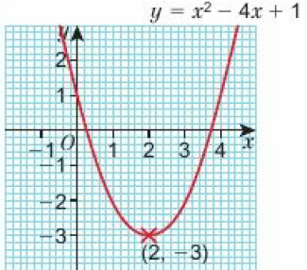
15 – Strengthen
Page 694
a.
x = 3.7 and x = 0.3

Slide 90
15 – Strengthen
Page 694
b. x = 3.7 and x = 0.3

Slide 91
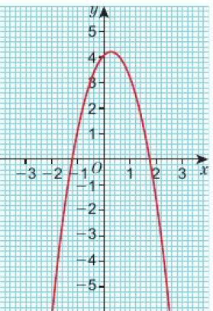
15 – Strengthen
Page 694
c. x = 1.7 and x = -1.2

Slide 92
15 – Strengthen
Page 694
a. y = x² - 4x + 1 b. x₁ = 3.605551275 0 = x² – 4x + 1 x₂ = 3.663632774 x² = 4x – 1 x₃ = 3.695203796 x = $\sqrt{4x−1}$ x₄ = 3.712252037 x_{n+1} = $\sqrt{4xn −1}$ x₅ = 3.721425553 c. x = 3.732
a. x_{n+1} = $\sqrt{8xn −1}$ b. 7.873

Slide 93
15 – Strengthen
Page 694
Graphs of Cubic Functions
a. i. x = -1, x = 1, x = -2 ii. (0, -2) b. i. x = -1, x = -2, x = -5 ii. (0, 10) c. i. x = -1, x = -2, x = 3 ii. (0, 6)
a. When y = 0 (x - 3)(x + 4)(x - 1) = 0 So there are three possible solutions: x – 3 = 0 hence x = 3 x + 4 = 0 hence x = -4 x – 1 = 0 hence x = 1

Slide 94
15 – Strengthen
Page 694
a. Roots: -3, 7, -2 y-intercept: -42 b. Roots: 10, -2, -1 y-intercept: 20 c. Roots: 2.5, -2, 1 y-intercept: 10 d. Roots: 3, 2 y-intercept: -54

Slide 95
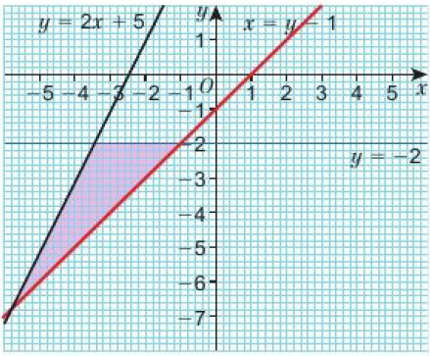
15 – Extend
Page 695
a. b. Area = 6.25 units²

Slide 96
15 – Extend
Page 695
a. Pentagon b. 540⁰
a. 7.5π
a. 1 b. 0 c. 2 d. 0 e. 2 f. 0
a. i. y = -a(x + 3)² - 4 ii. y = a(x - 4)² – 3 b. y = ax(x + 3)
6$\sqrt{5}$
a. x⁴ + 5x³ + 2x² – 8x b. 4

Slide 97
15 – Extend
Page 695
RHS = x(x - 2)(x + 2) = x(x² - 2x + 2x - 4) = x(x² - 4) = x³ - 4x
-n² + 4n + 20 = -(n - 2)² + 24 The largest value this can take is when n – 2 = 0, when n = 2.
(0, 15), (1, 16) and (6, 21)

Slide 98
15 – Extend
Page 695
x⁴ + 3x³ + 5x² + 5x + 2
a. x = 0.6, y = 4.2 b. x = -2.6, y = -0.4 x = -3.2, y = 2.7 x = 1.6, y = 0.6 c. x = -3.1, y = 6.5 x = 3.6, y = 3.2
5
a. 37° and 143° b. 11⁰, 191⁰
a. {x: 01 < x < 1.5} b. {x: -2 < x < 5}

Slide 99
15 – Unit Test
Page 695
Sample student answers
Student B gives the best answer as they have used the information on the graph and the equation given. Student A has calculated c correctly, but has incorrectly identified b.
Student C has incorrect values for b and c.

